Slide 1
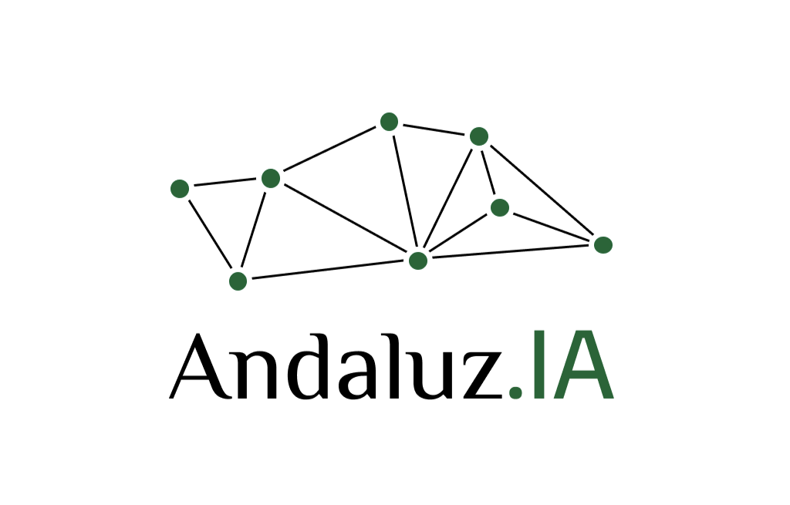

Variational Mixture of HyperGenerators for Learning Distributions over Functions
Ignacio Peis
Technical University of Denmark
ipeaz@dtu.dk
20 December 2023

Slide 2
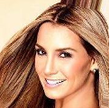
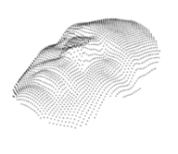
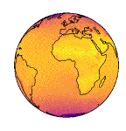
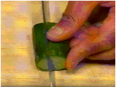
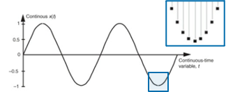

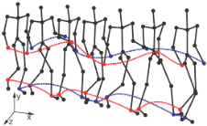
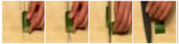
Motivation
<
We typically deal with discretized versions of data that are continuous in nature.
2D Images
3D Images
Polar data
Time series
Audio
Motion sequences
Video
Spatial
Temporal
Spatio-temporal

Slide 3
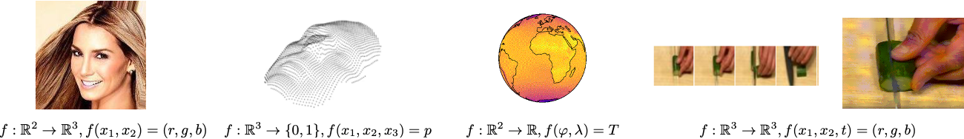
Motivation
<
Data can be expressed as a function over continuous coordinate systems.

Slide 4
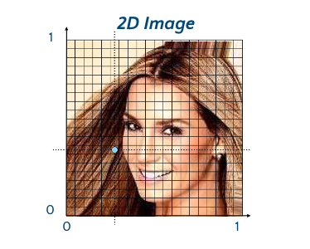
Motivation
<
Focusing on images:

Slide 5
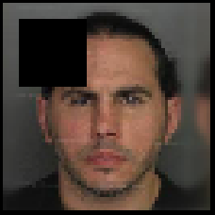
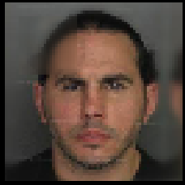
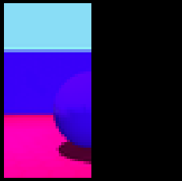
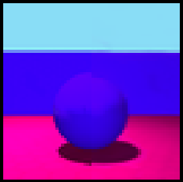
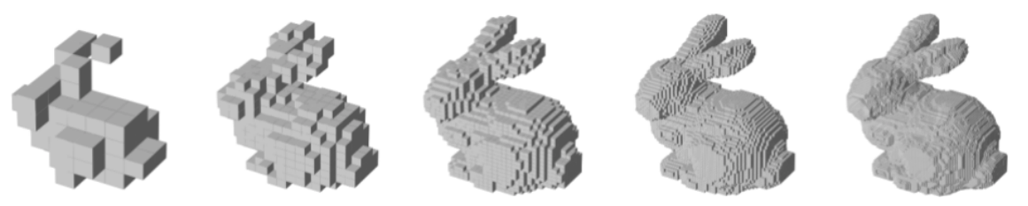
Motivation
<
This approach will easily allows for:
Inpainting [6,7]
Outpainting [6,7]
Superresolution [6,7]
Conditional Generation [6,7]
Interpolation
These ones require inference!

Slide 6
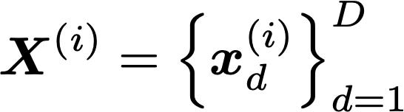
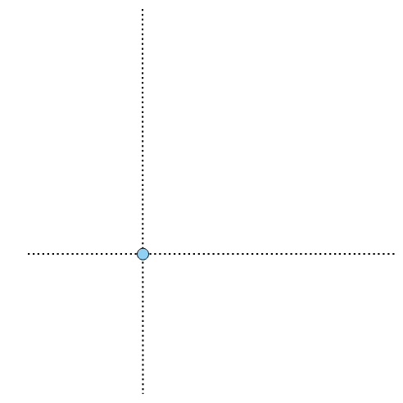

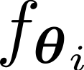
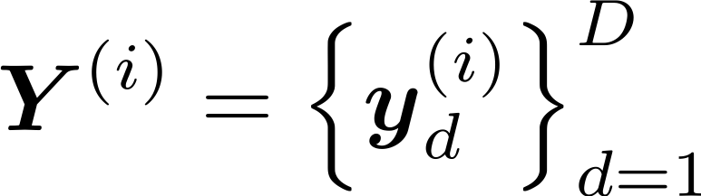

Implicit Neural Representations
INRs [20-22]
Data Generator
^{[20]} Sitzmann et at., 2020
^{[21]} Mescheder et at., 2019
^{[20]} Sitzmann et at., 2019

Slide 7
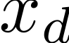
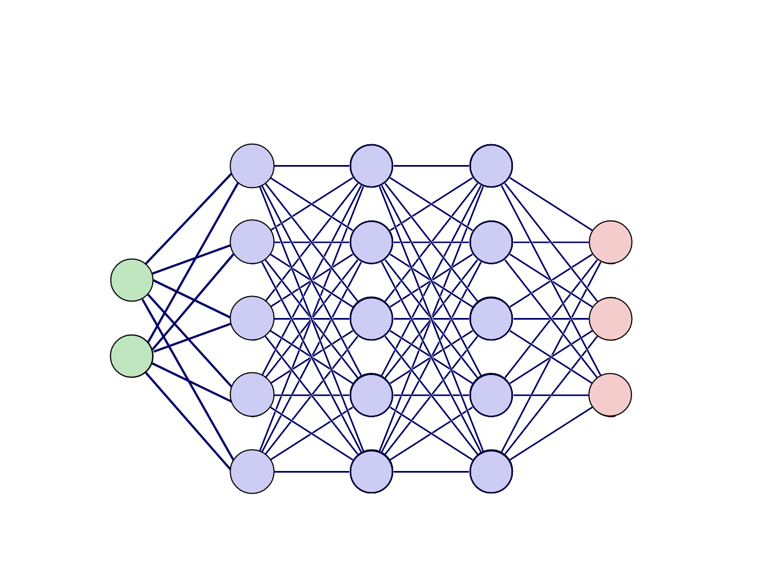
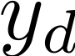
Implicit Neural Representations
INRs [20-22]
Data Generator
^{[20]} Sitzmann et at., 2020
^{[21]} Mescheder et at., 2019
^{[20]} Sitzmann et at., 2019

Slide 8
Implicit Neural Representations
INRs [20-22]
Data Generator
^{[20]} Sitzmann et at., 2020
^{[21]} Mescheder et at., 2019
^{[20]} Sitzmann et at., 2019

Slide 9
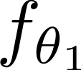
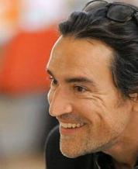
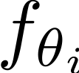
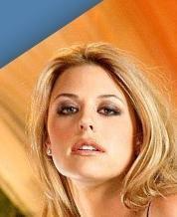

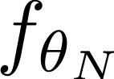
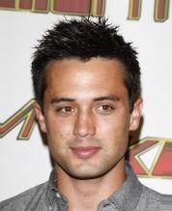
Implicit Neural Representations
INRs [20-22]
Learning distributions functions within a VAE framework.
Data generator is unique to each image
i=1
…
…
…
Data Generator
…
…
…
i=N
^{[20]} Sitzmann et at., 2020
^{[21]} Mescheder et at., 2019
^{[20]} Sitzmann et at., 2019

Slide 10
Deep Generative Models of INRs
<
How to scale to large datasets?
How to map a latent representation to an INR?

Slide 11
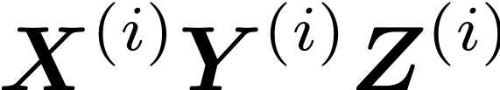
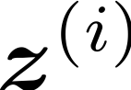
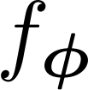
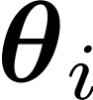
Deep Generative Models of INRs
<
HyperNetwork [23]
Data Generator
^{[23]} Ha et at., 2017

Slide 12
Deep Generative Models of INRs
<
Have , a summary representation of image.
HyperNetwork [23]
Data Generator
^{[23]} Ha et at., 2017

Slide 13
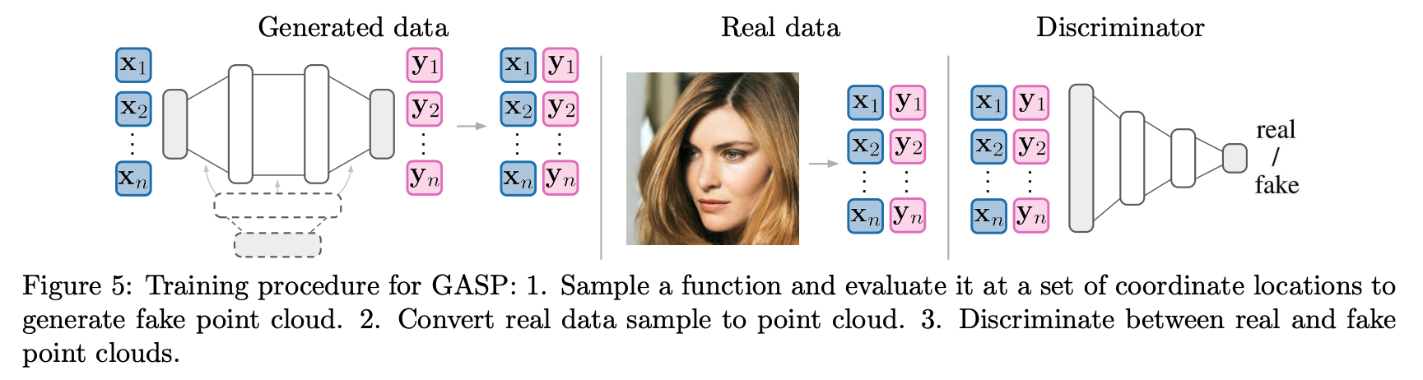

Previous work
<
GASP^{[5]}
Adversarial training:
Can’t tackle inference related tasks.
Point-wise Convolution
^{[5]} Dupont et at., 2020

Slide 14
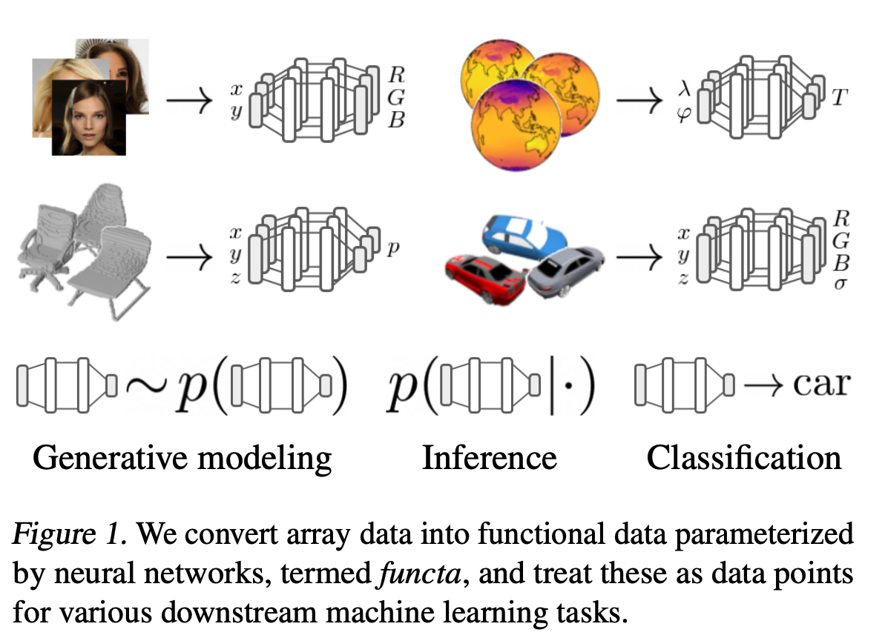
Previous work
<
Functas^{[6]}
Decoupled training:
Fit an INR per datapoint using SIREN^{[20]} and modulation vectors, named functas.
Train any generative model on the functa dataset of vectors.
Computationally expensive inference.
^{[6]} Dupont et at., 2022
^{[20]} Sitzmann et at., 2020

Slide 15
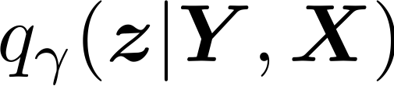
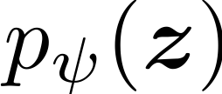
Deep Generative Models of INRs
How to infer the latent representation z?

Slide 16
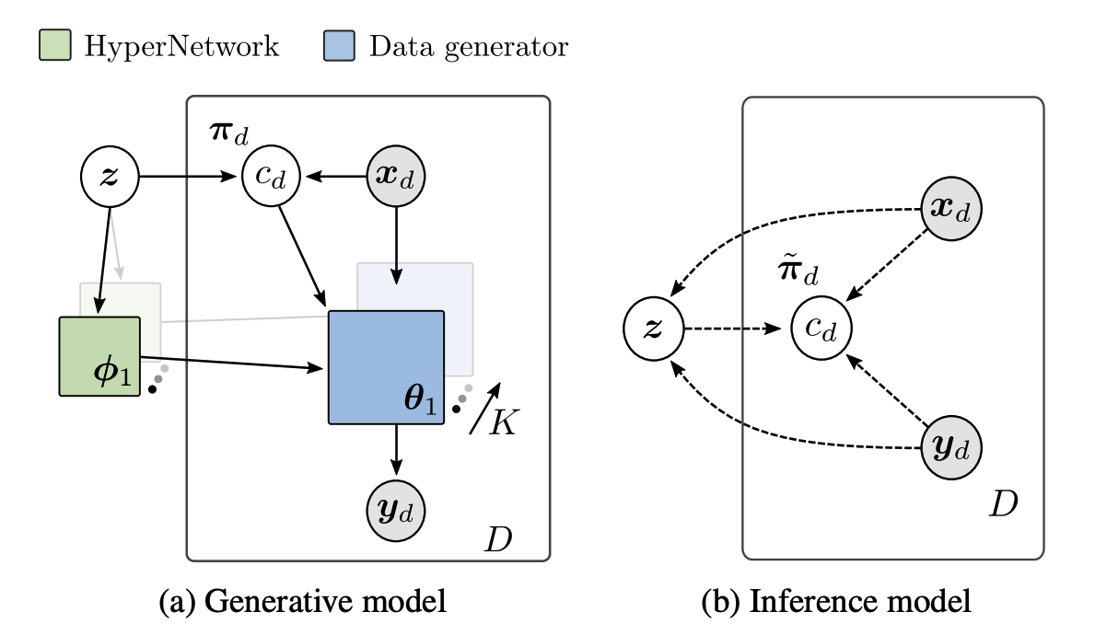
Proposed method: VAMoH
Variational Mixture of HyperGenerators

Slide 17
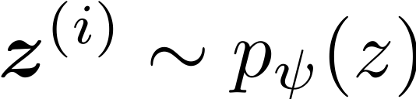
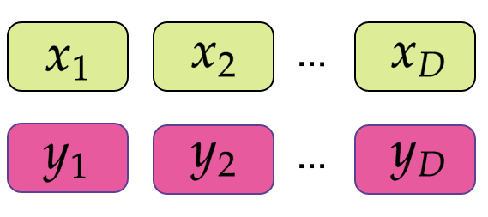
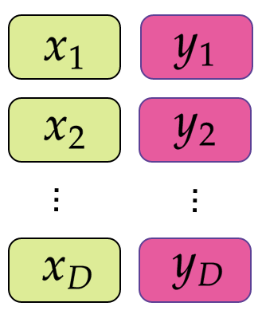
VAMoH
<
<
Encoder
Prior Distribution
Encoder
HyperNetwork
Data Generator
Posterior Distribution
: Latent Variable

Slide 18
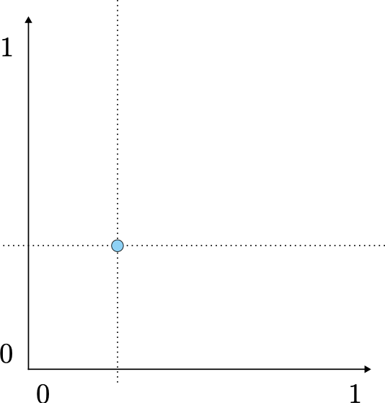
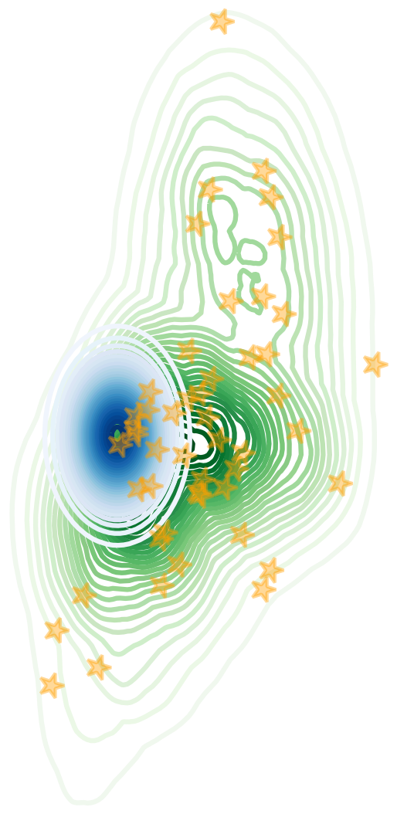
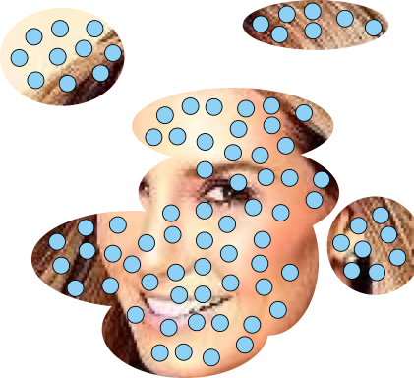
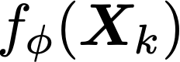
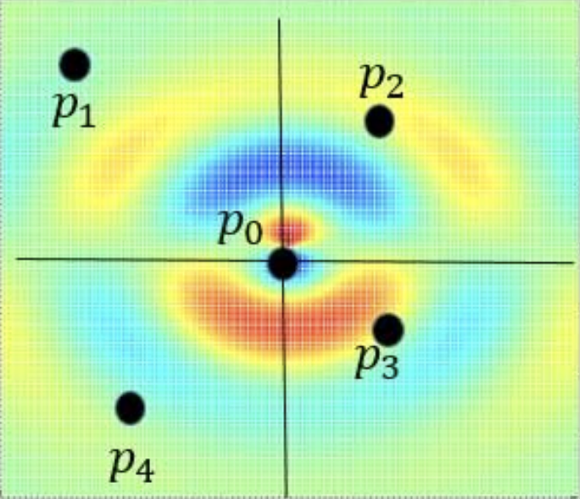

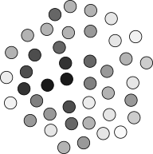

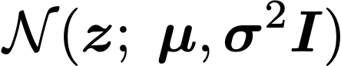
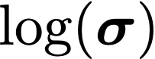

VAMoH
<
<
Encoder
PointConv^{[21]} encoder for point clouds.
PointConv
Point-wise encoder
^{[21]} Wu et at., 2019

Slide 19
VAMoH
<
<
Decoder
Prior Distribution
Encoder
HyperNetwork
Data Generator
Posterior Distribution
: Latent Variable

Slide 20
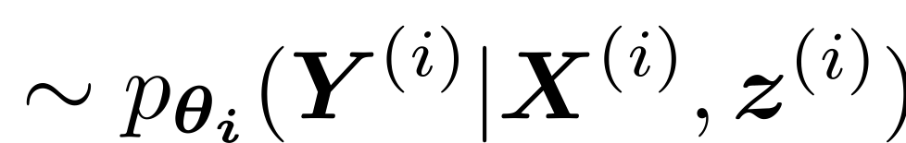
VAMoH
<
<
Reconstruction
Encoder
HyperNetwork
2
Data Generator
Posterior Distribution

Slide 21
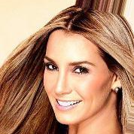
VAMoH
<
<
Super Resolution
Encoder
HyperNetwork
2
Data Generator
Posterior Distribution

Slide 22


VAMoH
<
<
Image Completion
Encoder
HyperNetwork
2
Data Generator
Posterior Distribution
Completion

Slide 23

VAMoH
<
<
Image Generation
Sample from Prior
Encoder
HyperNetwork
Data Generator

Slide 24
VAMoH
<
<
Image Generation
Sample from Prior
Encoder
HyperNetwork
Data Generator

Slide 25
VAMoH
<
<
Optimization
How to learn all these steps end-to-end from data?

Slide 26

VAMoH
<
<
Optimization
Encoder
HyperNetwork
2
Data Generator
Posterior Distribution
Aim: Learning latent variables z given data (intractable) objective)
How: Learn an approximation
Generative model:

Slide 27




VAMoH
<
<
Optimization
For a single data sample
Reconstruction
Regularization
For all samples in our dataset

Slide 28





VAMoH
<
<
‘Holes’ problem
Regularization Term:
We need to align the approximate posterior with the prior.
Problem:
If the prior is too simple, it hinders generation quality.
Solution:
Learn a more complex . with another NN.

Slide 29

VAMoH
<
<
Flow-based prior
More expressive prior using RealNVP (Real-valued, Non-Volume Preserving) Flow.
[23]

Slide 30












VAMoH
<
<
Mixture of HyperGenerators
Single HyperGenerator
HyperNetwork
2
Data Generator
Choose!
k=K
…
Mixture of HyperGenerators
…
k=1
HyperNetworks

Slide 31

VAMoH
<
<
Mixture of HyperGenerators
Image Reconstruction with Mixture of HyperGenerators
31

Slide 32


VAMoH
<
<
ELBO
For a single data sample
Reconstruction the features of the observed pixels
For all samples in our dataset
KL of the continuous latent variable
KL of the discrete latent variable
32

Slide 33
Experiments
<
Baselines
Model | Approach | Training Procedure | Generation | Reconstruction, Imputation, Super Resolution
GASP (2021) [5] | GAN | Minimax | Forward Pass | ❌
33

Slide 34

Experiments
<
Baselines
Model | Approach | Training Procedure | Generation | Reconstruction, Imputation, Super Resolution
GASP (2021) [5] | GAN | Minimax | Forward Pass | ❌
Functa (2022) [6] | Flow-based | Bilevel optimization | + Extra Generative Model
Optimization procedure(s)
per sample
34

Slide 35

Experiments
<
Baselines
Model | Approach | Training Procedure | Generation | Reconstruction, Imputation, Super Resolution
GASP (2021) [5] | GAN | Minimax | Forward Pass | ❌
Functa (2022) [6] | Flow-based | Bilevel optimization | + Extra Generative Model
Optimization procedure(s)
per sample
35

Slide 36

Experiments
<
Baselines
Model | Approach | Training Procedure | Generation | Reconstruction, Imputation, Super Resolution
GASP (2021) [5] | GAN | Minimax | Forward Pass | ❌
Functa (2022) [6] | Flow-based | Bilevel optimization | + Extra Generative Model
VaMoH (ours) | VAE-based | Single optimization | Forward Pass
Optimization procedure(s)
per sample
Forward pass
VAMoH provides a probabilistic generative model that is efficient, robust, and expressive for modeling distribution over functions.
36

Slide 37





Experiments
<
Datasets
PolyMNIST (28x28)
Shapes3D (64x64)
CelebA-HQ (64x64)
ERA5 (Polar)
ShapeNET (Voxels)

Slide 38

Experiments
<
Generation
CelebA-HQ
Shapes3D

Slide 39



Experiments
<
Generation
PolyMNIST
ERA5
ShapeNET

Slide 40




Experiments
<
Reconstructions

Slide 41


Experiments
<
Inference times
Reconstruction
Super-reconstruction

Slide 42





Experiments
<
Image completion

Slide 43
Conclusion
Thanks to learning distributions of functions, our proposed VAMoH can easily perform:
Generation.
Reconstruction.
Conditional generation.
Super resolution (interpolation).
While being:
Robust to partially observed data.
Expressive for generating high-quality data.
Efficient in terms of inference.

Slide 44


Further details
[Paper]
^{[25]} Koyuncu et at., 2023

Slide 45

References
[1] Campbell, A., Chen, W., Stimper, V., Hernandez-Lobato, J. M., & Zhang, Y. (2021, July). A gradient based strategy for hamiltonian monte carlo hyperparameter optimization. In International Conference on Machine Learning (pp. 1238-1248). PMLR.
[2] Caterini, A. L., Doucet, A., & Sejdinovic, D. (2018). Hamiltonian variational auto-encoder. Advances in Neural Information Processing Systems, 31.
[3] Salimans, T., Kingma, D., & Welling, M. (2015, June). Markov chain monte carlo and variational inference: Bridging the gap. In International conference on machine learning (pp. 1218-1226). PMLR.
[4] Ruiz, F. J., Titsias, M. K., Cemgil, T., & Doucet, A. (2021, December). Unbiased gradient estimation for variational auto-encoders using coupled Markov chains. In Uncertainty in Artificial Intelligence (pp. 707-717). PMLR.
[5] Dupont, E., Whye Teh, Y. &amp; Doucet, A.. (2022). Generative Models as Distributions of Functions. Proceedings of The 25th International Conference on Artificial Intelligence and Statistics, in Proceedings of Machine Learning Research 151:2989-3015.
[6] Dupont, E., Kim, H., Eslami, S. A., Rezende, D. J., & Rosenbaum, D. (2022, June). From data to functa: Your data point is a function and you can treat it like one. In International Conference on Machine Learning (pp. 5694-5725). PMLR.

Slide 46
References
[7] Kingma, D. P., & Welling, M. (2013). Auto-encoding variational bayes. arXiv preprint arXiv:1312.6114.
[8] Cremer, C., Li, X., & Duvenaud, D. (2018, July). Inference suboptimality in variational autoencoders. In International Conference on Machine Learning (pp. 1078-1086). PMLR.
[9] Bernardo, J. M. (1979). Expected information as expected utility. the Annals of Statistics, 686-690.
[10] Ma, C., Tschiatschek, S., Palla, K., Hernández-Lobato, J. M., Nowozin, S., & Zhang, C. (2018). Eddi: Efficient dynamic discovery of high-value information with partial vae. arXiv preprint arXiv:1809.11142.
[11] Ma, C., Tschiatschek, S., Turner, R., Hernández-Lobato, J. M., & Zhang, C. (2020). VAEM: a deep generative model for heterogeneous mixed type data. Advances in Neural Information Processing Systems, 33, 11237-11247.
[12] Child, R. (2020). Very deep vaes generalize autoregressive models and can outperform them on images. arXiv preprint arXiv:2011.10650.

Slide 47
References
[13] Nazabal, A., Olmos, P. M., Ghahramani, Z., & Valera, I. (2020). Handling incomplete heterogeneous data using vaes. Pattern Recognition, 107, 107501.
[14] Mattei, P. A., & Frellsen, J. (2019, May). MIWAE: Deep generative modelling and imputation of incomplete data sets. In International conference on machine learning (pp. 4413-4423). PMLR.
[15] Peis, I., Ma, C., & Hernández-Lobato, J. M. (2022). Missing Data Imputation and Acquisition with Deep Hierarchical Models and Hamiltonian Monte Carlo. arXiv preprint arXiv:2202.04599.
[16] Kraskov, A., Stögbauer, H., & Grassberger, P. (2004). Estimating mutual information. Physical review E, 69(6), 066138.
[17] Gong, W., Li, Y., & Hernández-Lobato, J. M. (2020). Sliced kernelized Stein discrepancy. arXiv preprint arXiv:2006.16531.
[18] Betancourt, M. (2017). A conceptual introduction to Hamiltonian Monte Carlo. arXiv preprint arXiv:1701.02434.

Slide 48
References
[19] Betancourt, M., & Girolami, M. (2015). Hamiltonian Monte Carlo for hierarchical models. Current trends in Bayesian methodology with applications, 79(30), 2-4.
[20] Sitzmann, V., Martel, J., Bergman, A., Lindell, D., & Wetzstein, G. (2020). Implicit neural representations with periodic activation functions. Advances in Neural Information Processing Systems, 33, 7462-7473.
[21] Mescheder, L., Oechsle, M., Niemeyer, M., Nowozin, S., & Geiger, A. (2019). Occupancy networks: Learning 3d reconstruction in function space. In Proceedings of the IEEE/CVF conference on computer vision and pattern recognition (pp. 4460-4470).
[22] Sitzmann, V., Zollhöfer, M., & Wetzstein, G. (2019). Scene representation networks: Continuous 3d-structure-aware neural scene representations. Advances in Neural Information Processing Systems, 32.
[23] Ha, D., Dai, A. M., & Le, Q. V. HyperNetworks. In International Conference on Learning Representations.
[24] Wu, W., Qi, Z., & Fuxin, L. (2019). Pointconv: Deep convolutional networks on 3d point clouds. In Proceedings of the IEEE/CVF Conference on computer vision and pattern recognition (pp. 9621-9630).
[25] Koyuncu, B., Sanchez-Martin, P., Peis, I., Olmos, P. M., & Valera, I. (2023). Variational Mixture of HyperGenerators for Learning Distributions Over Functions. In Proceedings of the 40th International Conference on Machine Learning, 2023.

Slide 49
Thank you!
ipeaz@dtu.dk

